Slide 1
Virtual Reality Learning Objects of Molecular Structures
Miguel A. Garcia-Ruiz, Arthur Edwards, Jorge R. Gutierrez-Pulido,Ricardo Acosta-Diaz
mgarcia@ucol.mx, arted@ucol.mx, jrgp@ucol.mx, acosta@ucol.mx
School of Telematics
University of Colima
Mexico
This research is being funded by a PROMEP grant from
the Mexican Ministry of Education, no. UCOL-EXB18

Slide 2
Highlights of this talk
Introduction and scope of the problem
The concept of learning object (LO)
Learning objects in virtual reality
Metadata for definition of VRLOs
Test bed for learning objects of molecular structure
Conclusions

Slide 3
Introduction
Problem: Chemistry students experience problems when learning and study molecular structures, since they are generally complex and abstract (Birk and Kurtz, 1999).
A number of didactic materials have been used:
  Model sets made of plastic or wood
  Drawings on blackboards
  Illustrations on books and Web pages
  Graphical 3D models downloaded from the Internet
  All have advantages,
  most of them are not enough for learning and teaching features like intramolecular and intermolecular bonds, rotations, conformations, etc. (Petersen, 1970)
  No extra information about the molecule.
  Some are inaccurate.

Slide 4
Introduction (contd.)
Last developments of virtual reality (VR) technology support the analysis and comprehension of molecular information, using scientific and information visualization techniques. VR is a computer-generated 3D space which is interactive, multisensorial and immersive (Burdea and Coiffet, 2003).
Our research proposes a definition of learning objects of molecular structures that include contextual information, as well as educational guidelines about its use, based on virtual reality technology.

Slide 5
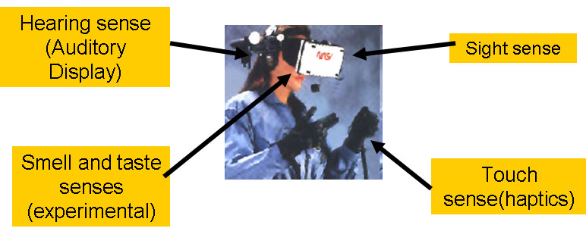
Introduction (Contd.)
A fully-immersive virtual reality system

Slide 6
Learning Objects
“Any digital resource that can be used and reused to support learning” (Wiley, 2005).
“An entity, being digital or not, that can be used, reused or make reference of, during the learning based on technology” (IEEE, 2002).

Slide 7
Learning Objects and Virtual Reality
Research about learning objects in VR has been scarce. Early investigations on development of metadata and learning objects to carry out catalogs of online virtual museums (Mourkoussis, White, Patel, Chmielewski, and K. Walczak, 2003), where metadata and the learning objects are shown in an online virtual reality environment. Those objects are described following international museum classification standards and codified in XML.

Slide 8
Metadata Definition for VRLOs
Possible to use many of the principles and guidelines of the IEEE Learning Task Committee (LTSC) for the definition of learning objects in VR, in conjunction with DCMI.
Their design is challenging, it is necessary to know technical and pedagogical aspects of virtual reality, especially about multimodality, computer graphics, sound, tactile information, and other types of sensory information.
In order to have a correct definition of metadata and learning objects in virtual reality, it is necessary to develop them based on software engineering methodology and a robust metadata definition.

Slide 9
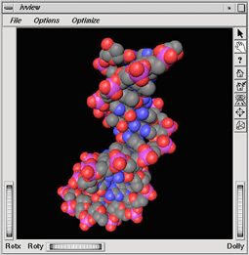
Test bed for learning objects of molecular structure
We have developed many 3D graphical models of molecular structures, which can be used in molecular biology, biochemistry and related courses. i.e. a virtual molecule of DNA that has been used for our studies

Slide 10
Test bed (contd.)
The development of 3D models of molecules, even if it is an automated task, is not trivial. Conversions of Protein DataBank (PDB) file format onto Virtual Reality Modeling Language (VRML) files are being made.
The importance of learning objects resides in their reusability, allowing the use of one learning object for various educational applications. Many molecular models can be reused for different courses and applications

Slide 11
Test bed (contd.)
According to our studies, it is necessary to ask a number of fundamental questions at early stages of the development of learning objects in virtual reality:
What are the input/output virtual reality devices that will be applied in conjunction with the VRLO?
Which of the sensory channels will be involved to interact with the VRLO, and how are they going to be integrated (multimodality)?
How much degree of immersion is it going to be needed?
How about the navigation style and the type of interactions the participant will carry out with the virtual environment that houses the learning object(s)?
Will the learning objects have representations? For instance, a molecular model can be represented as “ball and stick” or “CPK” types.
How are the characteristics of the virtual environment display? Is it going to be displayed on a computer monitor, a large projection screen, in a virtual reality head-mounted display? Will it be rear projected?
How are the characteristics of the audience? What is their average age? Are most of them passive students? Have they had previous experience with 3d models?
How are the characteristics of the hall or classroom where the VRLOs will be displayed and used? Does it become dark enough so a data projector can be effectively used?
The answers of the above questions will define certain metadata of the virtual learning object, particularly to define technical aspects of their educational use.

Slide 12
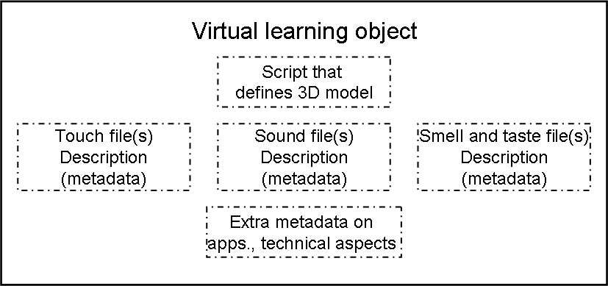
Our virtal object structure
Our proposal of a hypothetical structure of a VRLO, where the metadata of the 3D model, tactile, visual, auditory, gustatory and olfactory information, as well as extra information on its educational usage, is encapsulated.
We plan to program the VRLO using VRML or X3D, and the metadata definition will be defined in XML. It is also possible to use scripting languages like Python or Tcl/Tk for metadata and sensory information definition.
The virtual learning environments could reside in a digital library that can be locally or remotely accessed, as proposed by Garcia Ruiz (1999).

Slide 13
Conclusions
This is an early stage in VRLOs design.
The development and application of VRLOs is feasible if it is based on software engineering development methodologies, strong educational theories, and adequate technology application.
It also needs to be based on standardized learning object initiatives such as the ones from the IEEE and Dublin Core. Nowadays, this research project has produced hundreds of 3D models of molecules that will be integrated into VRLOs as test bed.
They can effectively support sciences learning, based on their adequate design and application.
We are currently planning usability and media comparison studies about the application of VRLOs of molecules using a computer monitor, a large projection screen, and a virtual reality head-mounted display.
Work in progress at the School of Telematics of the University of Colima, Mexico.
Research is being funded by a PROMEP grant from the Mexican Ministry of Education, no. UCOL-EXB18.

Slide 14
References
1. J.P. Birk and M.J.J. Kurtz , Effect of Experience on Retention and Elimination of Misconceptions about Molecular Structure and Bonding, Journal of Chemical Education, 1999, 76, Pp 124-128.
2. M.B. Nakhleh. Why Some Students Don’t Learn Chemistry, Chemical Misconceptions. Journal of Chemical Education, 1992, 69(3), Pp 191-196.
3. Q.R. Petersen. Some Reflections on the Use and Abuse of Molecular Models. 1970. Journal of Chemical Education, 47(1).
4. Y.J. Dor and M. Barak. Computerized Molecular Modeling as a Collaborative Learning Environment. In Hoadley, C., & Roschelle, J. (Eds.), Proceedings of the Computer Support for Collaborative Learning (CSCL) 1999 Conference. Stanford University, Palo Alto, CA, 1999.
5. C. Dede, M. Salzman, B. Loftin, and K. Ash (in press). Using virtual reality technology to convey abstract scientific concepts. In M. J. Jacobson & R. B. Kozma (Eds.), Learning the Sciences of the 21st Century: Research, Design, and Implementing Advanced Technology Learning Environments. Hillsdale, NJ: Lawrence Erlbaum.
6. G. Sankaranarayanan, S. Weghorst, M. Sanner, A. Gillet, and A. Olson. Role of Haptics in Teaching Structural Molecular Biology. Proceedings of the11th Symposium on Haptic Interfaces for Virtual Environment and Teleoperator Systems (HAPTICS’03), 2003.
7. M.A. Garcia-Ruiz and J.R. Gutierrez-Pulido. An Overview of Auditory Display to Assist Comprehension of Molecular Information. Interacting with Computers, 18(4), 2006.
8. D.A. Wiley. Connecting learning objects to instructional design theory: A definition, a metaphor, and a taxonomy. In D. A. Wiley (Ed.), The Instructional Use of Learning Objects: Versión en línea, 2005. Recuperada el 20/5/2005 del World Wide Web: http://reusability.org/read/chapters/wiley.doc
9. CUDI. Reunión de la Comisión Académica de Objetos de Aprendizaje, Corporación Universitaria para el Desarrollo del Internet, Guadalajara, Jal., 4 de julio, 2002.
10. IEEE. IEEE 1484.12.1, Learning Technology Standards Committee, Learning Object Metadata standard, Draft Standard for Learning Object Metadata, 2002.

Slide 15
References (contd.)
11. J. Fiaidhi, Virtual Scenebeam: a Learning Object Model for Collaborative Virtual Learning Environments. Informatics in Education, 2004, 3(2), Pp 191-218.
12. G. Burdea y P. Coiffet. Virtual Reality Technology, Second Edition with CD-ROM. John Wiley and Sons. ISBN: 0471360899, 2004.
13. R.W. Sherman y A.B. Craig. Understanding Virtual Reality. San Francisco, CA: Morgan Kaufman, 2003.
14. M.C. Salzman, C. Dede, y B. Loftin. ScienceSpace: Virtual realities for learning complex and abstract scientific concepts. In Proceedings of IEEE Virtual Reality Annual International Symposium, 1996. Pp. 246 253.
15. M.A. García Ruiz, R. Acosta Dìaz, M. Andrade Aréchiga. Exploring Multimodal Virtual Environments for Learning Biochemistry Concepts. Proceedings of Ed-Media, AACE, Lugano, Switzerland, 2004.
16. N. Mourkoussis, M. White, M. Patel, J. Chmielewski, and K. Walczak. AMS – Metadata for Cultural Exhibitions using Virtual Reality. Proceedings of the 2003 Dublin Core Conference: Supporting Communities of Discourse and Practice - Metadata Research and Applications, Seattle, Wa., E.U.A., 2003.
17. Memorandum Dublin Core metadata Initiative and IEEE Learning Technology Standards. Available at: http://dublincore.org/documents/dcmi-ieee-mou/index.shtml, 2006.
18. G. Bou Bauzá, C. Trinidad Cascudo, and L. Huguet Borén. E-learning. Madrid: Ediciones Anaya Multimedia, 2004.
19. M.A. García Ruiz. Bibliotecas Digitales y Ambientes Virtuales para la Enseñanza de la Biología Molecular, Breve Panorama General. IX Coloquio de Automatización de Bibliotecas, CGSTI, University of Colima, 1999.

